Slide 1
Air_Ticket
Price Prediction
By Sarvesh Kesharwani

Slide 2
Outline
Introduction to the Air Ticket Price Data
^{Exploration and Visualizations}
^{Insights from Data}
^{Summary}

Slide 3
^{Introduction to}
^{Air Ticket Price Data}

Slide 4
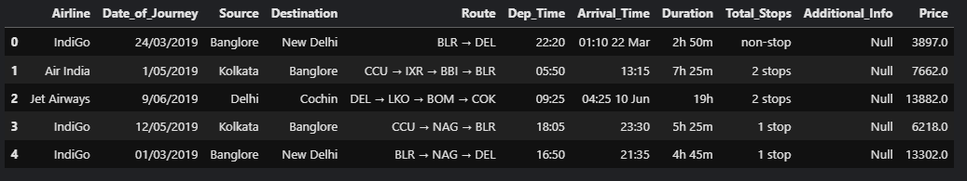
No_of_columns = 11
No_of_Rows = 10684

Slide 5
Data Transformation

Slide 6
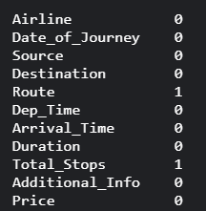
Removal of null rows
Count of null values in each column

Slide 7
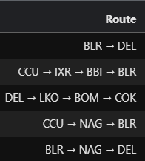
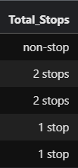
Route and Total_Stops are highly correlated to each other

Slide 8
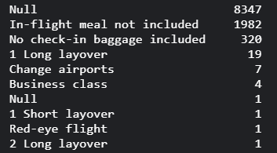
Additional_Info contains almost 78% “Null” Values

Slide 9

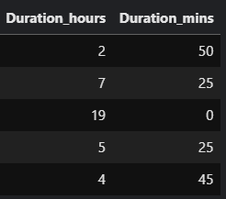

Slide 10



Slide 11



Slide 12
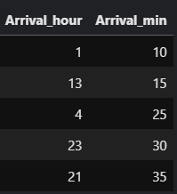


Slide 13
Insights from Analysis

Slide 14
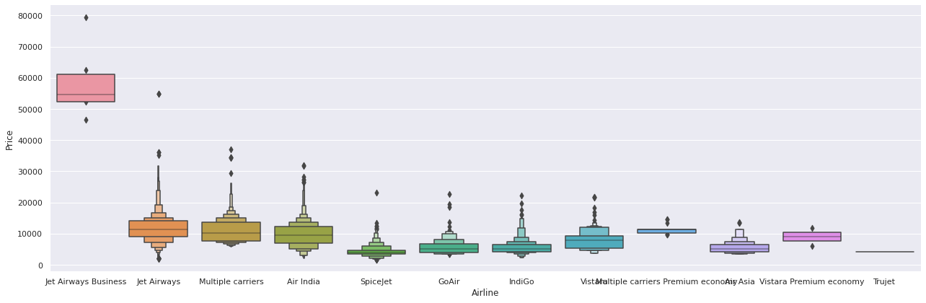
From graph we can see that Jet Airways Business have the highest Price.
Apart from the first Airline almost all are having similar median

Slide 15
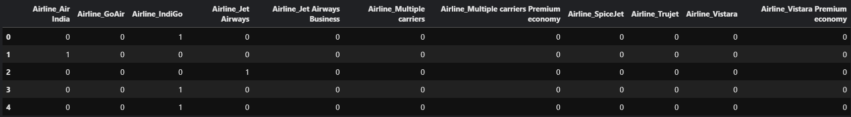
One Hot Encoding of Airline Column

Slide 16
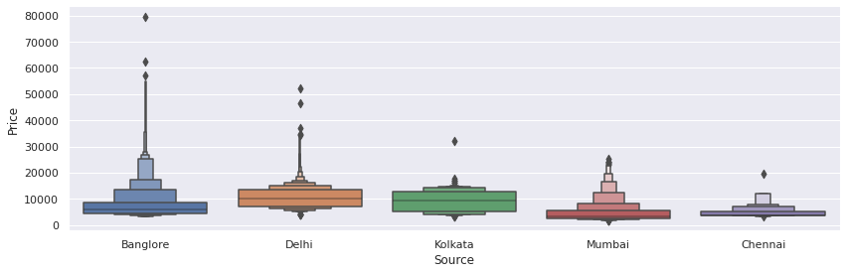

Slide 17
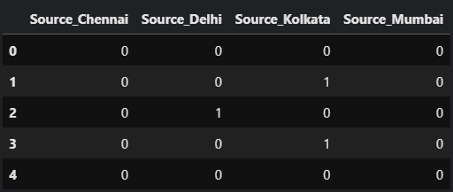
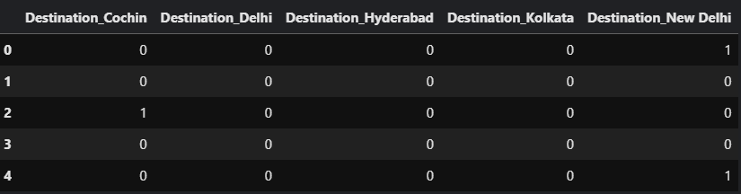
One Hot Encoding of Source and Destination Column

Slide 18
Feature Selection

Slide 19
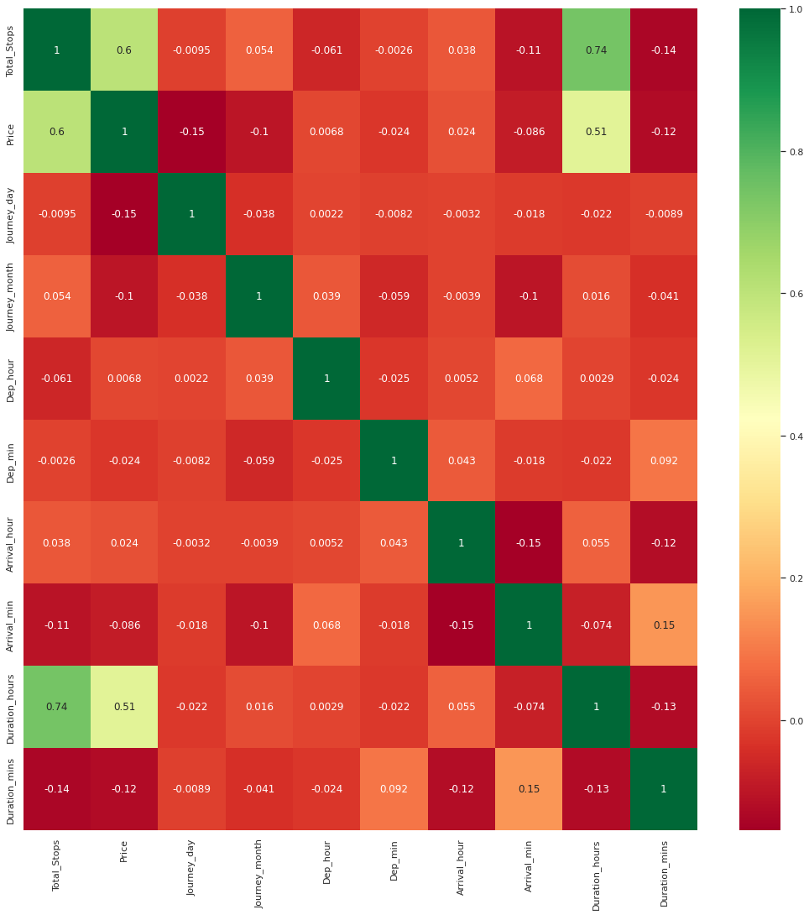
correlation between Independent and dependent attributes

Slide 20
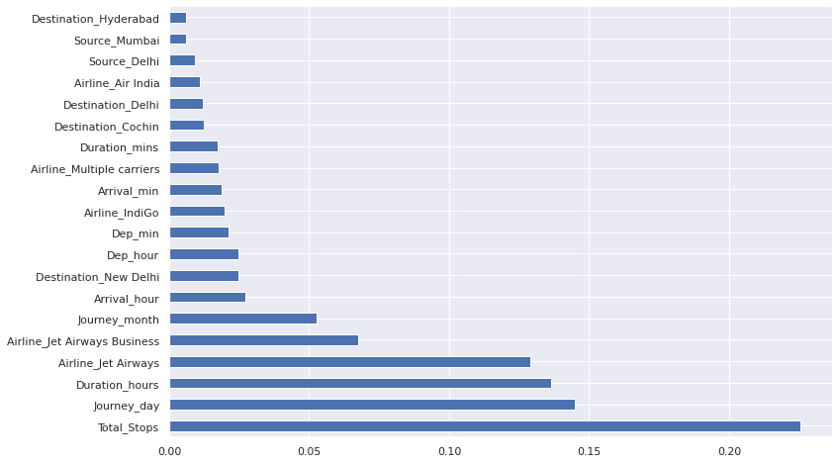
Finding Important feature using ExtraTreesRegressor

Slide 21
using
Random Forest Regressor
Model Training

Slide 22
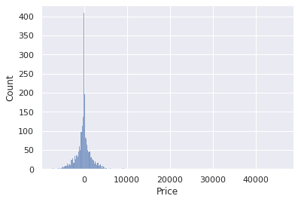
Distribution of error in prediction is normal

Slide 23
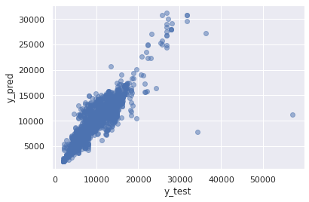
Predicted and Actual Price have positive relation

Slide 24
Model Evaluation
MAE: 1175.707716560957
MSE: 4374706.754454131
RMSE: 2091.5799660673106
R-squared Score: 0.7971108743672111

Slide 25
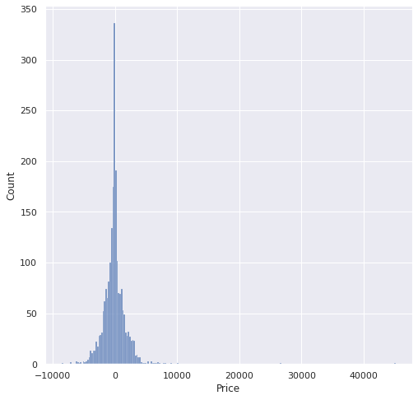
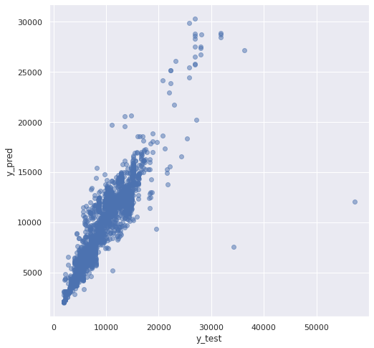
Results after Tunning of Parameters

Slide 26
Model Performance After Tunning
MAE: 1175.707716560957
MSE: 4374706.754454131
RMSE: 2091.5799660673106
R-squared Score: 0.8119130507910237

Slide 27
Summary

Slide 28
Thank You

Slide 29
Questions?

